Slide 1

Adaboost for Face Detection
Slides adapted from P. Viola and Tai-Wan Yue

Slide 2
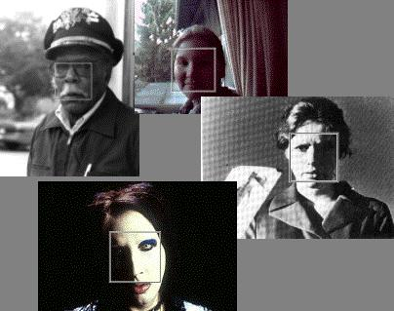
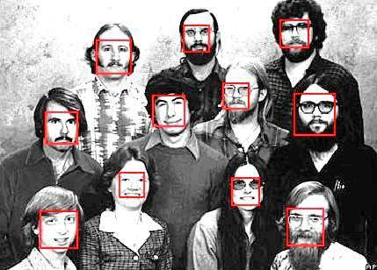
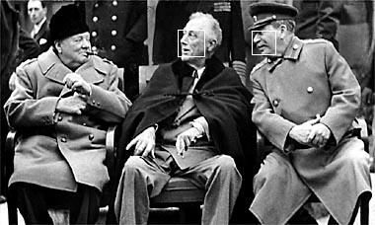
The Task of
Face Detection

Slide 3

Basic Idea
Slide a window across image and evaluate a face model at every location; no. of locations where face is present is very very small

Slide 4
Challenges
Slide a window across image and evaluate a face model at every location
Sliding window detector must evaluate tens of thousands of location/scale combinations
Faces are rare: 0–10 per image
  For computational efficiency, we should try to spend as little time as possible on the non-face windows
  A megapixel image has ~10⁶ pixels and a comparable number of candidate face locations
  To avoid having a false positive in every image, the false positive rate has to be less than 10⁻⁶

Slide 5
The Viola/Jones Face Detector
A seminal approach to real-time object detection
Key ideas
  Integral images for fast feature evaluation
  Boosting for feature selection
  Attentional cascade for fast rejection of non-face windows
P. Viola and M. Jones. Rapid object detection using a boosted cascade of simple features. CVPR 2001.
P. Viola and M. Jones. Robust real-time face detection. IJCV 57(2), 2004.

Slide 6
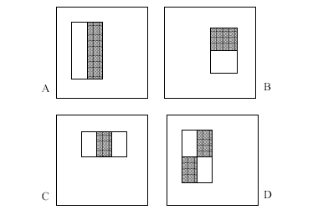
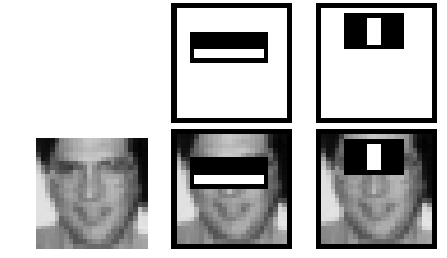

Image Features
Rectangular filters
Local features: Subtract sum of pixels in white area from the sum of pixels in black area; 2-rectangle features (A and B), 3-rectangle feature (C) and 4-rectangle feature (D)

Slide 7
Image Features
Rectangular filters
Too many features
Local features: Subtract sum of pixels in white area from the sum of pixels in black area
In a 24 x 24 patch with 4x4 detector, there are over 160,000 locations for rectangles

Slide 8
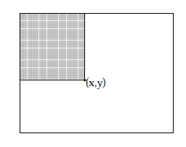


Image Features
Integral Image: An intermediate representation of the image for rapid calculation of rectangle features
s(x,y) is the cumulative row sum, s(x,-1) =0 and ii(-1, y) = 0; the integral image can be computed in one pass over the original image
Reject non-face windows through a cascade of classifiers and boosting
IMAGE
SUB-WINDOW
Classifier 1
T
Classifier 2
T
Classifier 3
T
FACE
F
F
F
NON-FACE
NON-FACE
NON-FACE

Slide 9
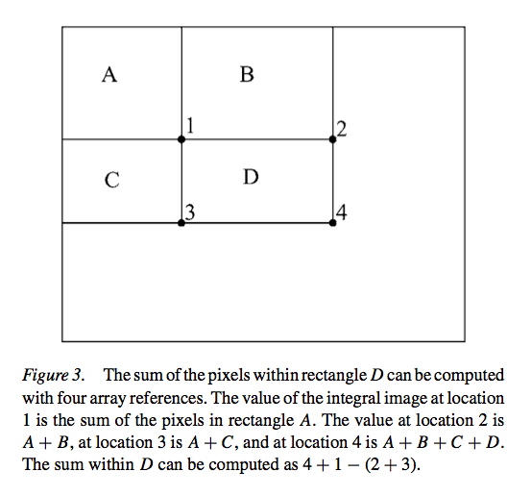
Rectangle Features from Integral Image
Rectangle features are somewhat primitive and coarse, they are sensitive to presence of edges, bars, and other simple structure
Generating a large no. of these features and their computational efficiency compensates for this.
Notes:
In order to get D, subtract both 3 and 2 but that removes the values in A twice so you have to add it back.

Slide 10
Face Detector
Scan the input at many scales
Starting at the base scale in which faces are detected at 24x24 pixels, a 384x288 pixel image is scanned at 12 scales each a factor 1.25 larger than the last
Any rectangle feature can be evaluated at any scale and location in a few operations
Face detection @15 fps for the entire image

Slide 11
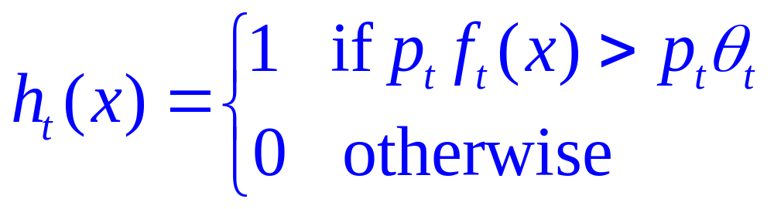
Weak Learners for Face Detection
Hypothesis: A very small no. of 160K (x4) features for each image sub-window can be formed to find an effective classifier (face vs. non-face)
AdaBoost is used both to select the features and train the classifier
Weak learner: a single rectangle feature that best separates positive and negative examples; so weak classifier is a thresholded single feature (can be viewed as a single node decision tree)
value of rectangle feature
parity
threshold
window

Slide 12
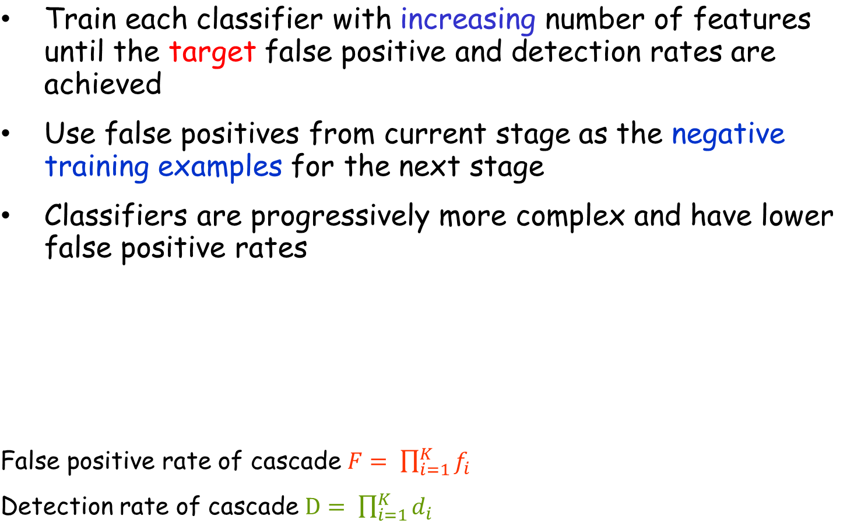
Cascade of classifiers
ROC Curve
IMAGE
SUB-WINDOW
Classifier 1
Classifier 2
Classifier 3
% False Pos
T
T
T
FACE
0
50
100
F
F
F
NON-FACE
NON-FACE
NON-FACE
% Detection
0

Slide 13
Boosting
Training set contains face and nonface examples
  Initially, with equal weight
For each round of boosting:
  Evaluate each rectangle filter on each example
  Select best threshold for each filter
  Select best filter/threshold combination
  Reweight examples
Computational complexity of learning: O(MNK)
  M rounds, N examples, K features

Slide 14

Face Detection using Adaboost

Slide 15
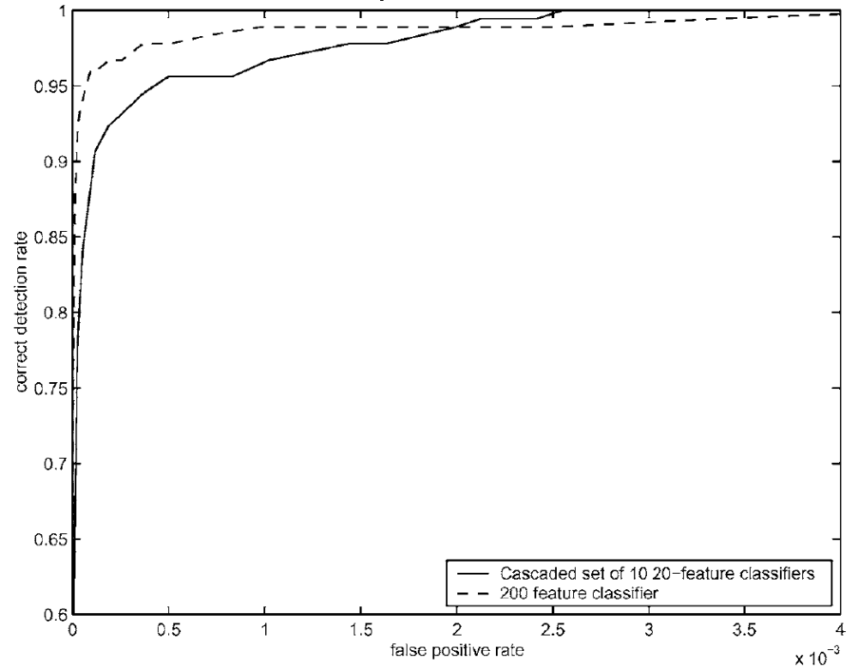
ROC Curves Cascaded Classifier to Monolithic Classifier
Speed of cascade classifier is 10 times faster

Slide 16
ROC Curves Cascaded Classifier to Monolithic Classifier
There is little difference between the two in terms of accuracy.
There is a big difference in terms of speed.
  The cascaded classifier is nearly 10 times faster since its first stage throws out most non-faces so that they arenever evaluated by subsequent stages.

Slide 17
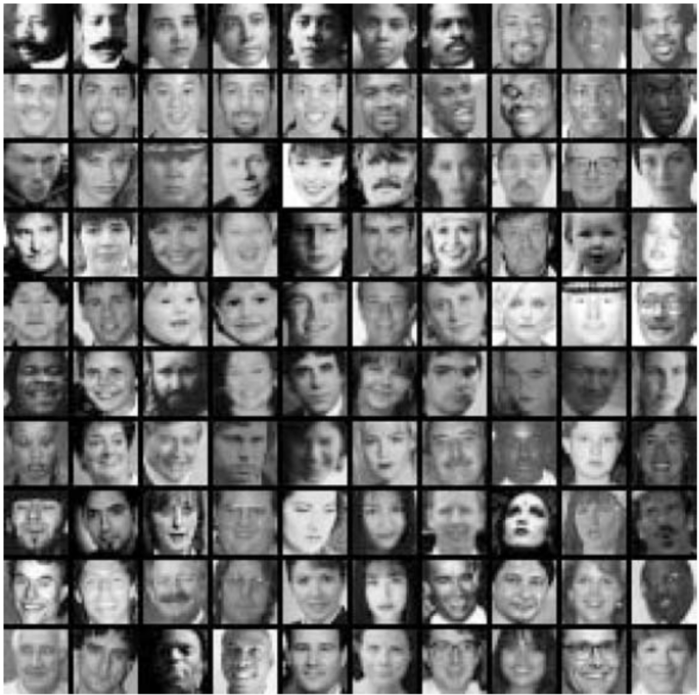
Face Detection System
Training Data
  5000 faces
    All frontal, rescaled to
    24x24 pixels
  9500 million non-faces
  Faces are normalized
    Scale, translation
Many variations
  Across individuals
  Illumination
  Pose

Slide 18
Structure of the Detector Cascade
Combining successively more complex classifiers in cascade
  32 stages
  included a total of 4297 features
All Sub-Windows
1
T
2
T
3
T
4
T
5
T
6
T
7
T
8
T
32
T
Face
F
F
F
F
F
F
F
F
F
Reject Sub-Window

Slide 19
Structure of the Detector Cascade
2 features, reject 50% non-faces, detect 100% faces
10 features, reject 80% non-faces, detect 100% faces
25 features
All Sub-Windows
50 features
by algorithm
1
T
2
T
3
T
4
T
5
T
6
T
7
T
8
T
32
T
Face
F
F
F
F
F
F
F
F
F
Reject Sub-Window

Slide 20
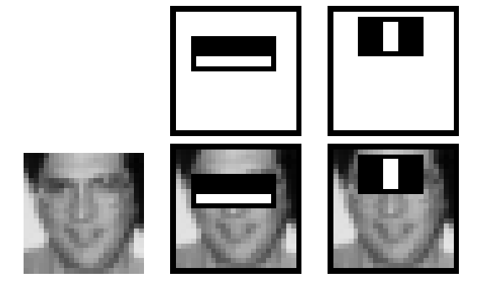
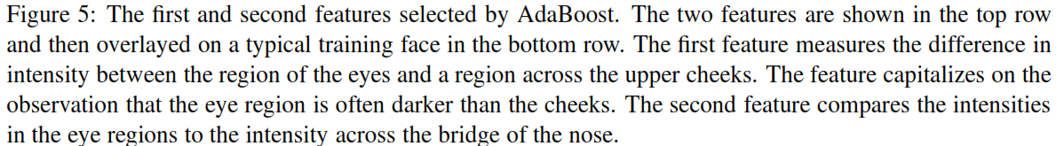
Feature Selection

Slide 21
Speed of the Final Detector
On a 700 Mhz Pentium III processor, the face detector can process a 384 ×288 pixel image in about .067 seconds”
  15 times faster than previous detector of comparable accuracy (Rowley et al., 1998)
Average of 8 features evaluated per window on test set

Slide 22
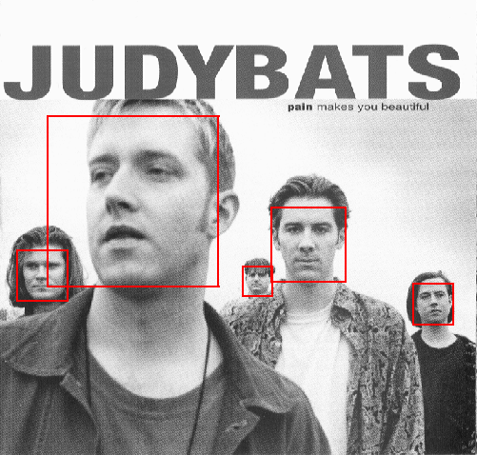
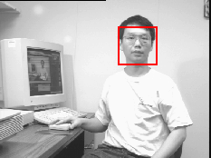
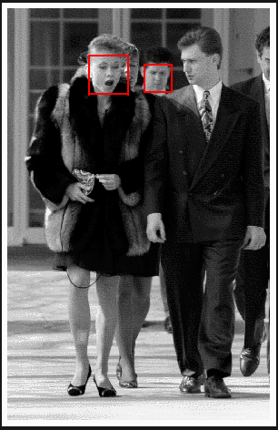
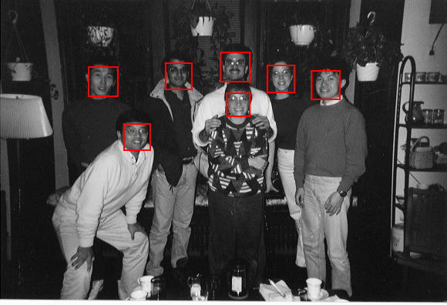
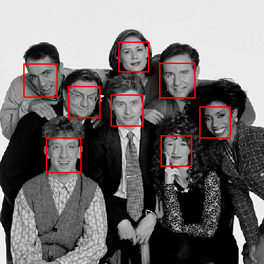
Output of Face Detector on Test Images

